Slide 1
SUPERVISED QUADTREES:
a new algorithm for
local data science
LEVI JOHN WOLF
levi.john.wolf@bristol.ac.uk

Slide 2
LOCAL MODELS IN DATA SCIENCE
CLUSTERING REGRESSION
UNDERSTANDING QUADTREES
APPLYING QUADTREE REGRESSION
THE SUPERVISED QUADTREE

Slide 3
LOCAL MODELS IN DATA SCIENCE
reverberations of a local revolution
CLUSTERING REGRESSION
UNDERSTANDING QUADTREES
APPLYING QUADTREE REGRESSION
THE SUPERVISED QUADTREE

Slide 4
LOCAL MODELS, LOCAL PREDICTIONS

Slide 5
LOCAL MODELS IN DATA SCIENCE
reverberations of a local revolution
CLUSTERING REGRESSION
UNDERSTANDING QUADTREES
APPLYING QUADTREE REGRESSION
THE SUPERVISED QUADTREE

Slide 6
LOCAL MODELS IN DATA SCIENCE
reverberations of a local revolution
CLUSTERING REGRESSION
finding fault lines in effect stability
UNDERSTANDING QUADTREES
APPLYING QUADTREE REGRESSION
THE SUPERVISED QUADTREE

Slide 7
Späth (1979)’s three-stage process
- CLUSTER: find clusters in the data
- ESTIMATE: fit the model using clusters as a feature
- REFINE: flip poorly-fit observations to a different cluster
Heuristic (i.e. not optimal), slow+computationally intensive, likelihood-dependent, even in the
seriously improved spatial variant provided by Sugasawa and Murakami (2021)
No guarantee of recovering the original classes
BEFORE THE SUPERVISED QUADTREE

Slide 8
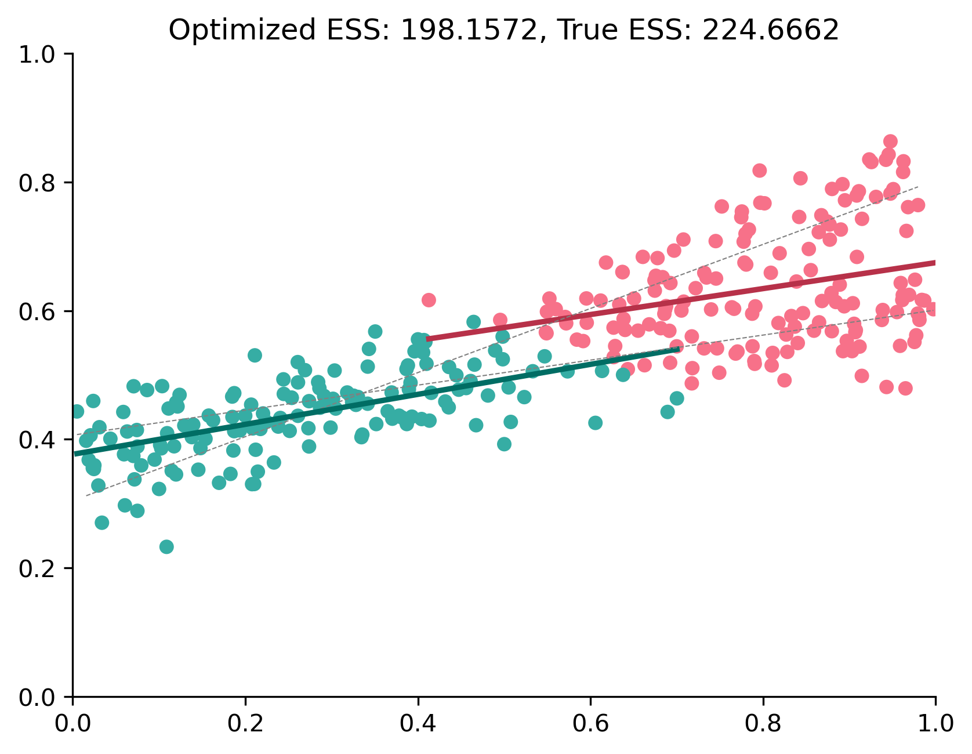
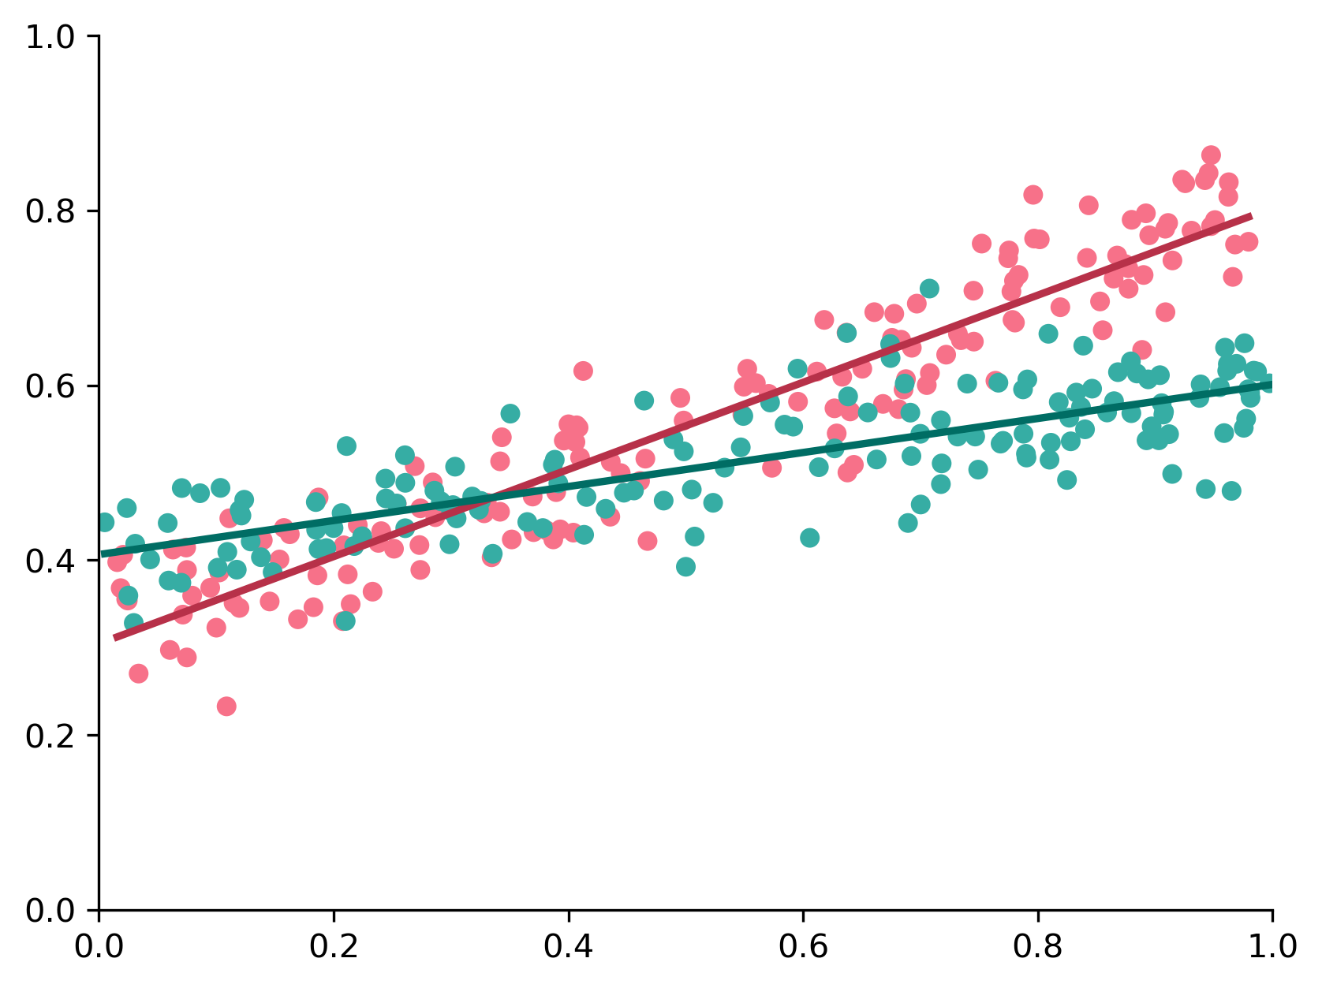
ITERATIVE CLUSTERING REGRESSION

Slide 9
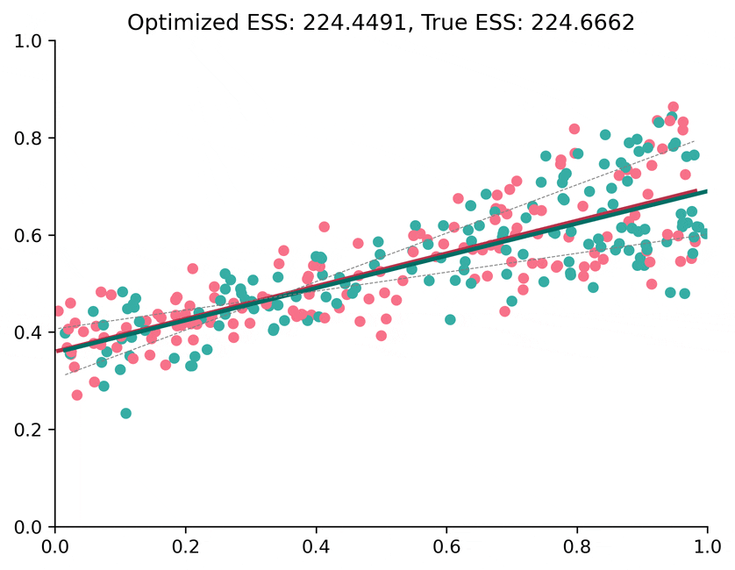
ITERATIVE CLUSTERING REGRESSION

Slide 10
OPTIMAL-ish BREAK
ITERATIVE CLUSTERING REGRESSION

Slide 11
TRUE BREAK
ITERATIVE CLUSTERING REGRESSION

Slide 12
Späth (1979)’s three-stage process
- CLUSTER: find clusters in the data
- ESTIMATE: fit the model using clusters as a feature
- REFINE: flip poorly-fit observations to a different cluster
Heuristic (i.e. not optimal), slow+computationally intensive, likelihood-dependent, even in the
seriously improved spatial variant provided by Sugasawa and Murakami (2021)
No guarantee of recovering the original classes
Anselin & Amaral (2023)
- COMBINE: Combine spatial and feature similarity
- SPAN: compute a MST over the combined affinity matrix
- PRUNE: remove MST links to create clusters according to (SSR – (SSR_{a} + SSR_{b}))
Spends degrees of freedom judiciously; n-clusters x n-features interactions
Remains fully within the standard Wald/LRT/Chow-based testing framework
MSTs can be quite unstable over Cross-validation
Requires prior knowledge of the deepest number of clusters
Avoids overfitting, since splits could be made below j
BEFORE THE SUPERVISED QUADTREE

Slide 13
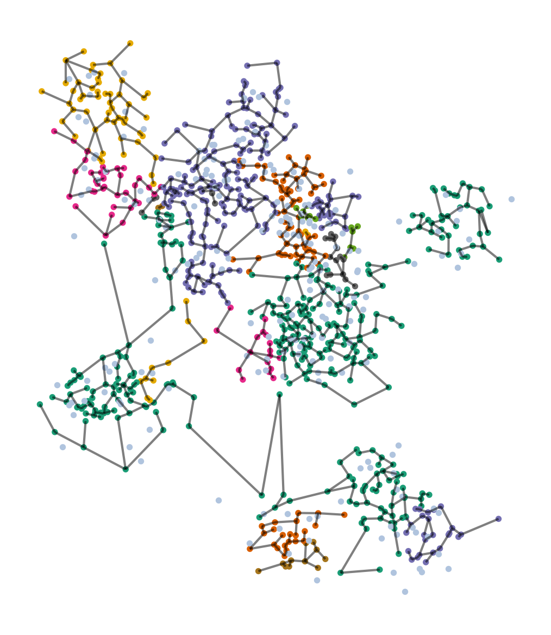
SKATER REGRESSION

Slide 14
MST Blues
- finnicky in CV
- no total order
- can’t do out of sample
SKATER REGRESSION

Slide 15
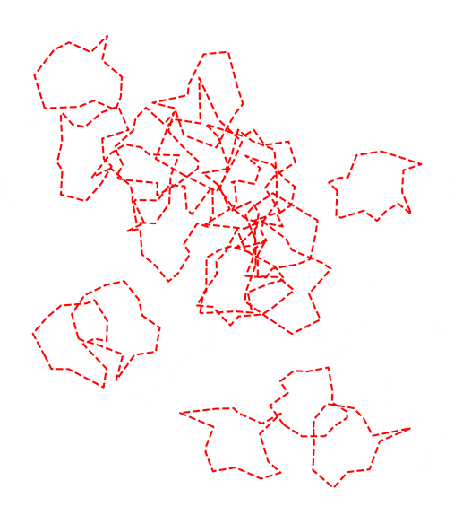
MST Blues
- finnicky in CV
- no total order
- can’t do out of sample
MST CHANGES DRAMATICALLY UNDER CV

Slide 16
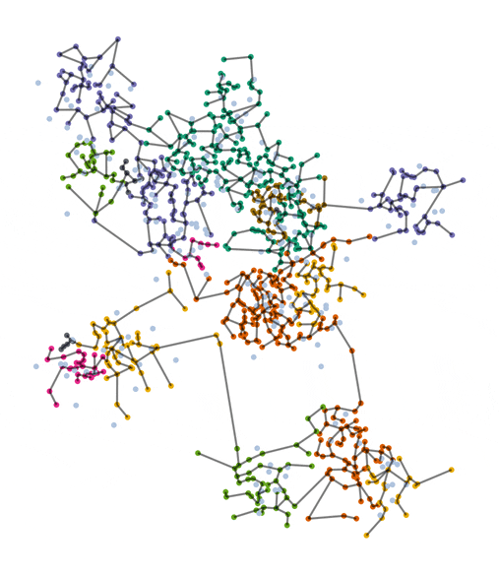
Distant in some splits, neighbors in others!
MST Blues
- finnicky in CV
- no total order
- can’t do out of sample
TREE ADJACENCY IS NOT FULL SIMILARITY

Slide 17
To whom should this connect?
MST Blues
- finnicky in CV
- no total order
- can’t do out of sample
ITERATIVE MST IS NOT FULL MST

Slide 18
LOCAL MODELS IN DATA SCIENCE
reverberations of a local revolution
CLUSTERING REGRESSION
finding fault lines in effect stability
UNDERSTANDING QUADTREES
spatial splits for spatial fits
APPLYING QUADTREE REGRESSION
THE SUPERVISED QUADTREE

Slide 19

QUADTREES IN IMAGE COMPRESSION

Slide 20
SPEND DETAIL WHERE ITS NEEDED MOST

Slide 21
0. INITIALIZE
SPLIT
2. PRUNE
3. FINALIZE
Fit a global model across all observations
Recursively find quadrants where you can improve upon global
“Roll up” useless leaf:feature interactions depth-first
Interpret the pruned global model as you need
THE SUPERVISED QUADTREE

Slide 22
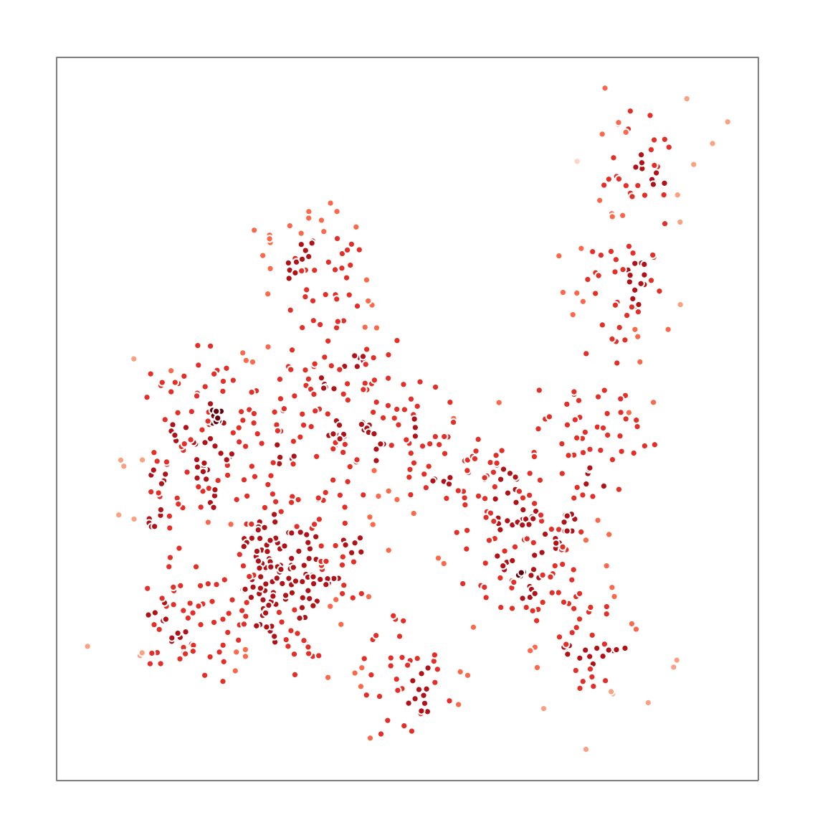
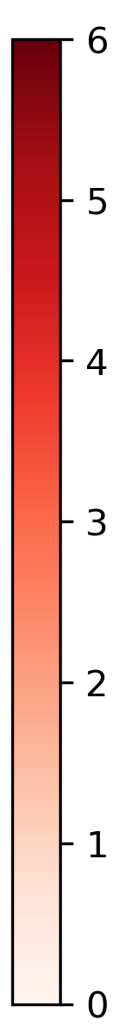
0
WALK DOWN THE DEPTH LADDER

Slide 23
c | x₁
1 | x₁₁
1 | x₁₂
1 | x₁₃
1 | x₁₄
1 | x₁₅
… | …
1 | x_{1n}
0
WALK DOWN THE DEPTH LADDER

Slide 24
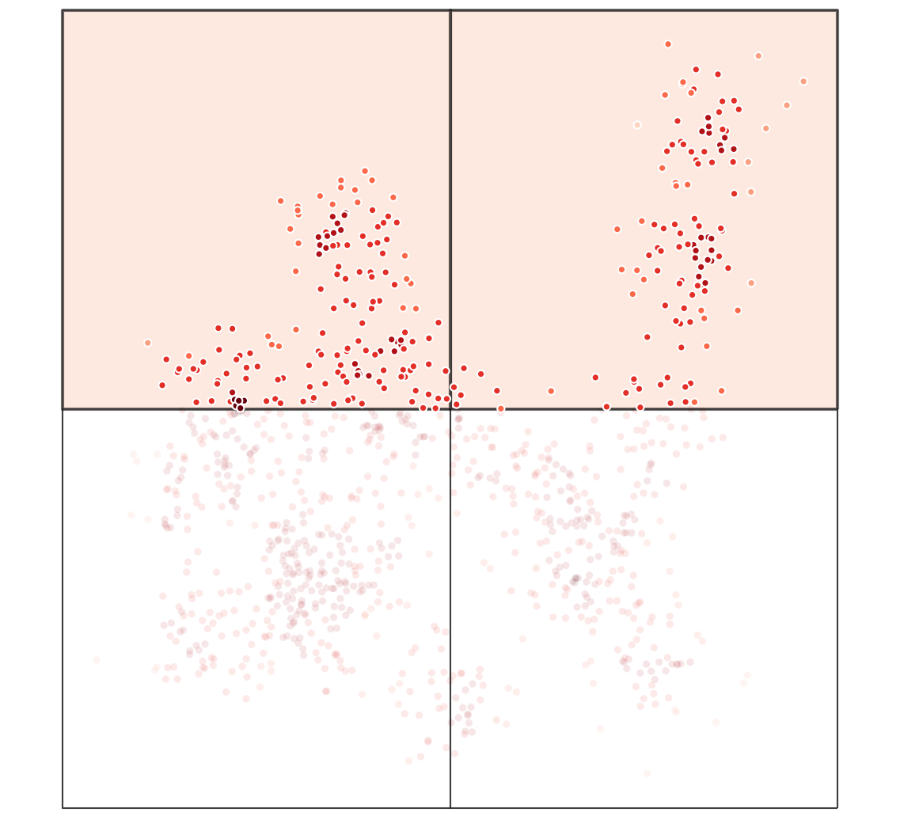
2
1
4
3
WALK DOWN THE DEPTH LADDER
Notes:
Inside of the parent square, can we make a better prediction if we introduce a fixed effect x interaction terms for the child? If so, do so.

Slide 25
2
1
c | c₁ | c₂
0 | 1 | 0
0 | 1 | 0
0 | 0 | 1
0 | 0 | 1
1 | 0 | 0
… | … | …
1 | 0 | 0
x₁:c | x₁:c₁ | x₁:c₂
0 | x₁₁ | 0
0 | x₁₂ | 0
0 | 0 | x₁₃
0 | 0 | x₁₄
x₁₅ | 0 | 0
… | … | …
x_{1n} | 0 | 0
4
3
WALK DOWN THE DEPTH LADDER
Notes:
Inside of the parent square, can we make a better prediction if we introduce a fixed effect x interaction terms for the child? If so, do so.

Slide 26
2
1
c | c₁ | c₂
0 | 1 | 0
0 | 1 | 0
0 | 0 | 1
0 | 0 | 1
1 | 0 | 0
… | … | …
1 | 0 | 0
x₁:c | x₁:c₁ | x₁:c₂
0 | x₁₁ | 0
0 | x₁₂ | 0
0 | 0 | x₁₃
0 | 0 | x₁₄
x₁₅ | 0 | 0
… | … | …
x_{1n} | 0 | 0
4
3
WALK DOWN THE DEPTH LADDER
Notes:
Inside of the parent square, can we make a better prediction if we introduce a fixed effect x interaction terms for the child? If so, do so.

Slide 27
2
1
c | c₁ | c₂
0 | 1 | 0
0 | 1 | 0
0 | 0 | 1
0 | 0 | 1
1 | 0 | 0
… | … | …
1 | 0 | 0
x₁:c | x₁:c₁ | x₁:c₂
0 | x₁₁ | 0
0 | x₁₂ | 0
0 | 0 | x₁₃
0 | 0 | x₁₄
x₁₅ | 0 | 0
… | … | …
x_{1n} | 0 | 0
4
3
WALK DOWN THE DEPTH LADDER
Notes:
Inside of the parent square, can we make a better prediction if we introduce a fixed effect x interaction terms for the child? If so, do so.

Slide 28
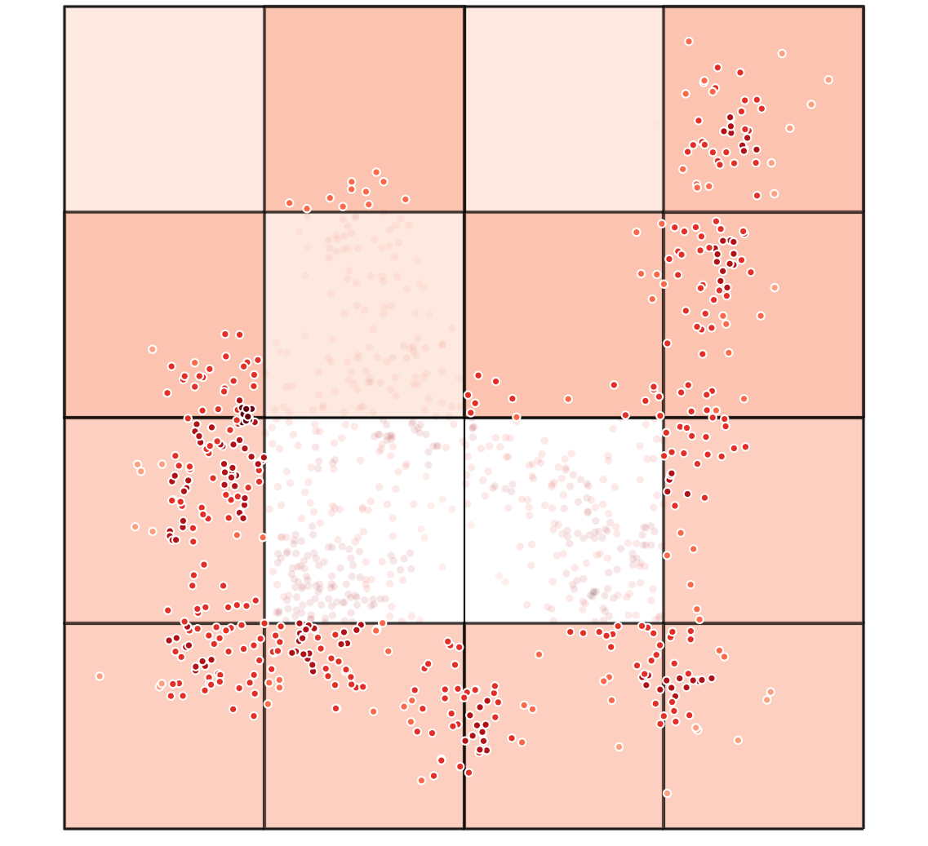
WALK DOWN THE DEPTH LADDER
Notes:
This next level is comparing only against level 2. highlighted, all this data is “used” in the new models at this level.

Slide 29
22
21
12
11
24
23
14
13
42
41
32
31
44
43
34
33
WALK DOWN THE DEPTH LADDER
Notes:
This next level is comparing only against level 2. highlighted, all this data is “used” in the new models at this level.

Slide 30
22
21
12
11
24
23
14
13
42
41
32
31
44
43
34
33
WALK DOWN THE DEPTH LADDER
Notes:
This next level is comparing only against level 2. highlighted, all this data is “used” in the new models at this level.

Slide 31
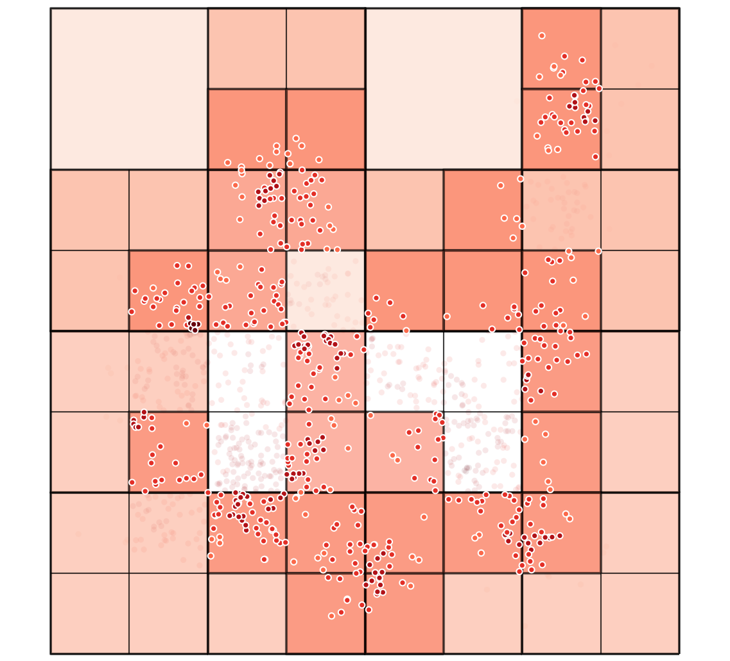
WALK DOWN THE DEPTH LADDER

Slide 32
243
WALK DOWN THE DEPTH LADDER

Slide 33
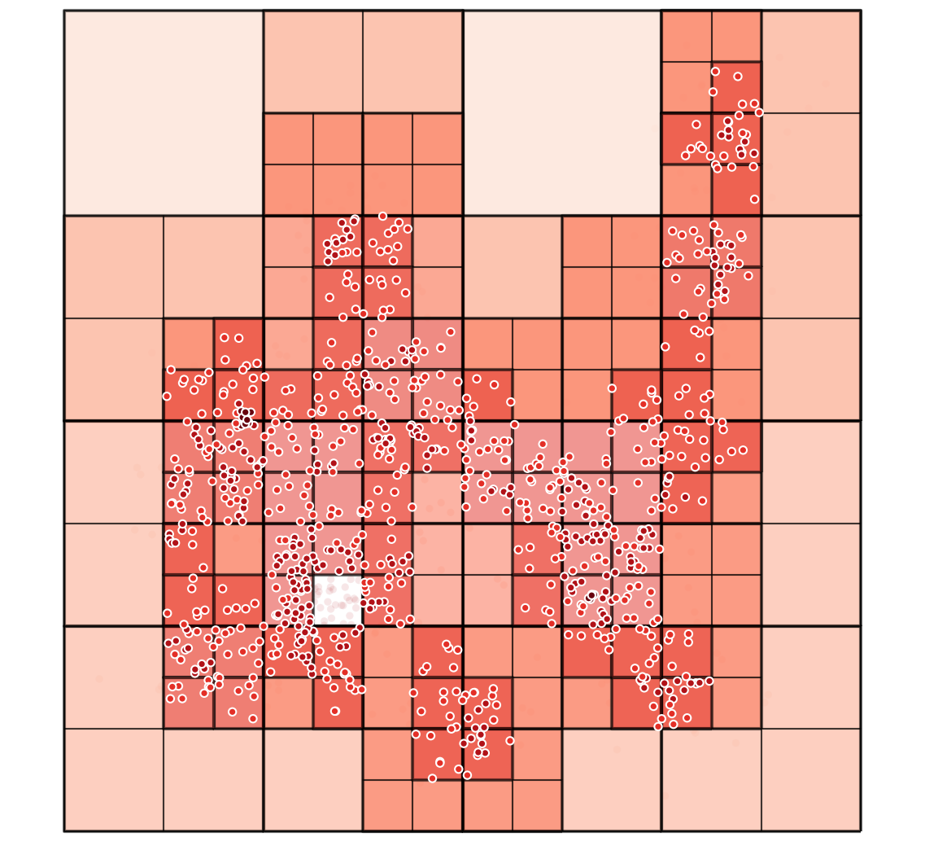
WALK DOWN THE DEPTH LADDER

Slide 34
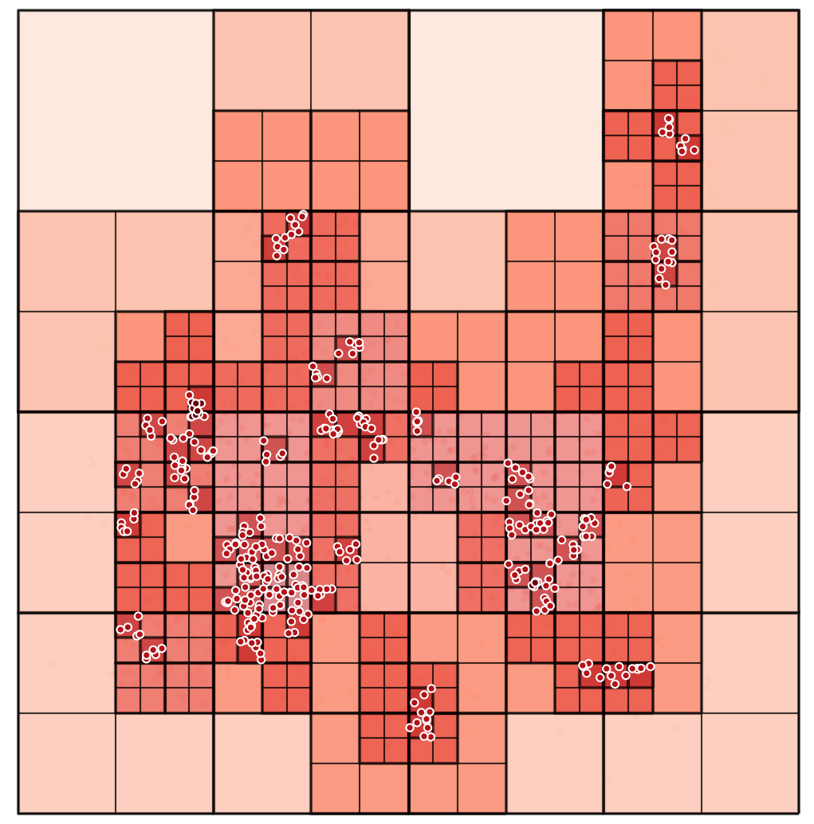
WALK DOWN THE DEPTH LADDER

Slide 35
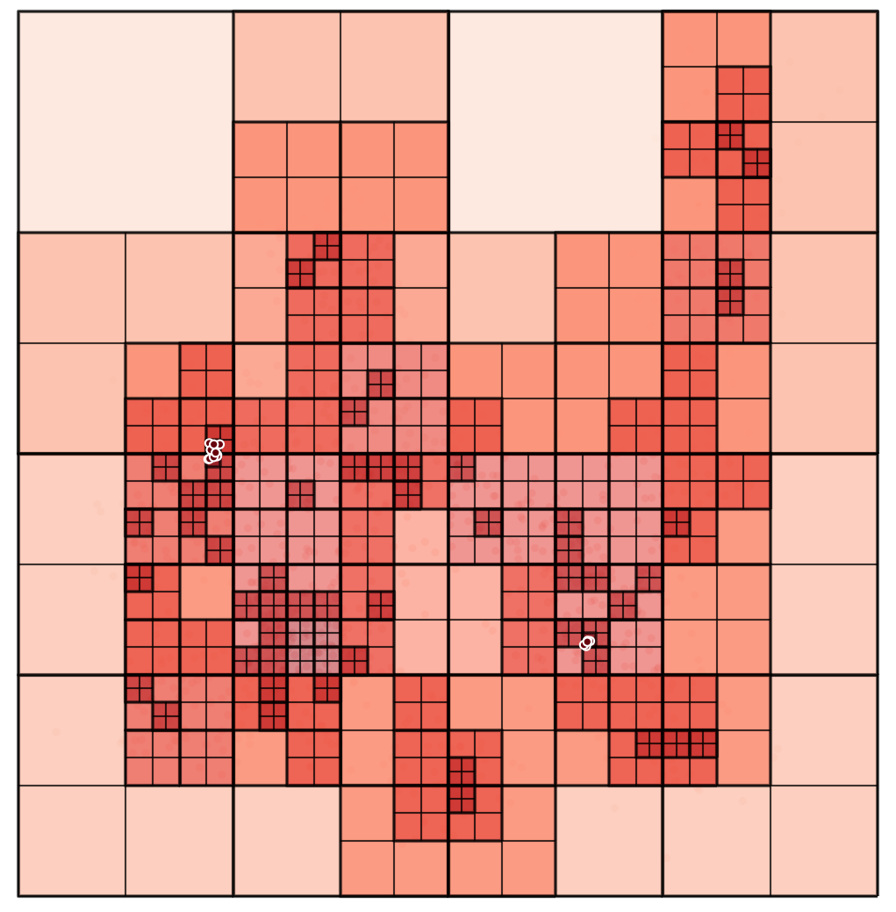
WALK DOWN THE DEPTH LADDER

Slide 36
323414
WALK DOWN THE DEPTH LADDER

Slide 37
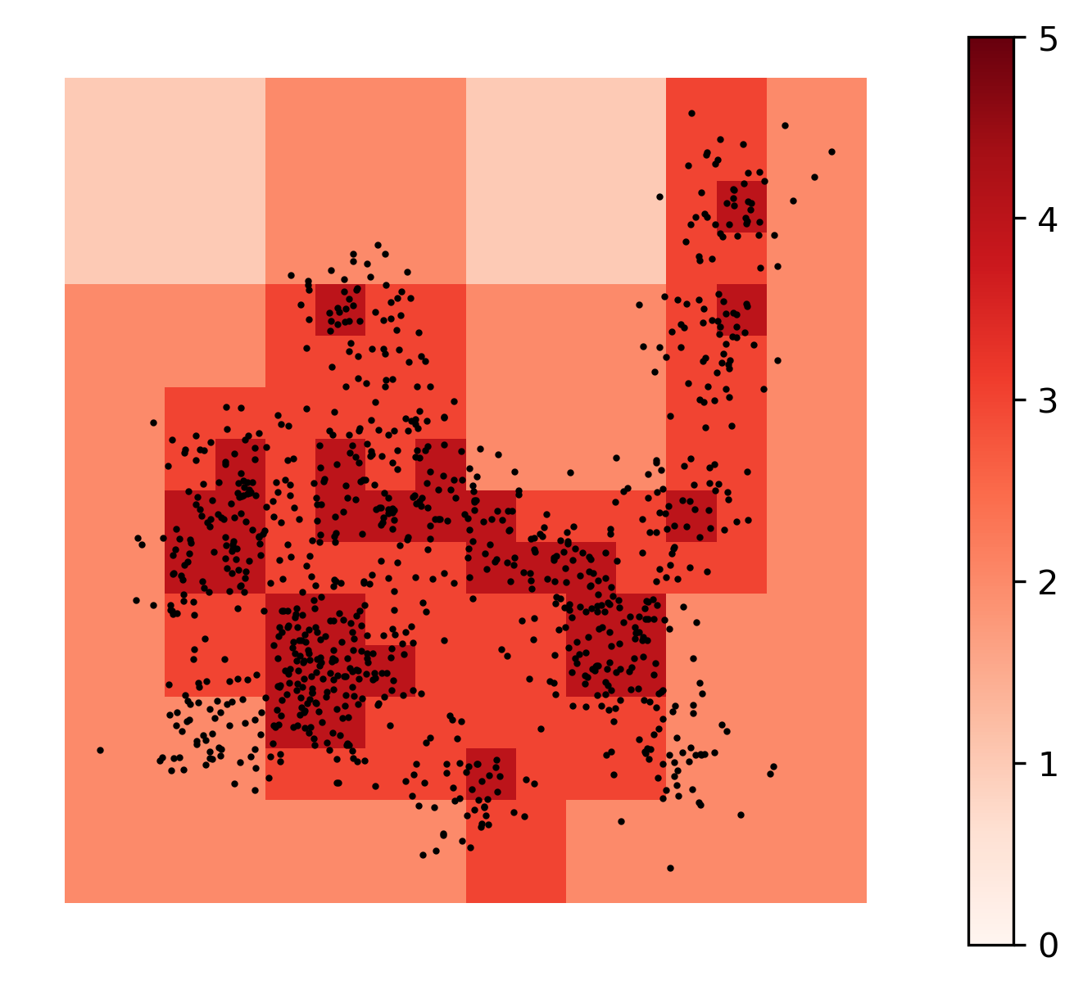
SuperQT
- stable in CV
- totally ordered
- simple out of sample and update
QUADTREES ARE FAIRLY STABLE IN CV

Slide 38

SuperQT
- stable in CV
- totally ordered
- simple out of sample and update
QUADTREES ARE FAIRLY STABLE IN CV

Slide 39
TOTALLY ORDERED
An observation will nest exactly into one cell at any given depth, and fit depth is a function of both fit and density, and big jumps in depth are rare.
QUADTREES ARE FAIRLY STABLE IN CV

Slide 40
OUT-OF-BAG
For interpolating predictions within frame,
we always have a model
Always 2
2 or 21
4112
or
411
QUADTREES ARE FAIRLY STABLE IN CV

Slide 41
OUT-OF-BAG
For interpolating predictions within frame,
we always have a model
For extrapolating predictions outside frame,
we always use model 0.
QUADTREES ARE FAIRLY STABLE IN CV

Slide 42
OUT-OF-BAG
For interpolating predictions within frame,
we always have a model
For extrapolating predictions outside frame,
we always use model 0.
UPDATING
Treat 0 as a child of some larger frame and prepend all cells with its new index
QUADTREES ARE FAIRLY STABLE IN CV

Slide 43
2
1
OUT-OF-BAG
For interpolating predictions within frame,
we always have a model
For extrapolating predictions outside frame,
we always use model 0.
UPDATING
Treat 0 as a child of some larger frame and prepend all cells with its new index
4
3
QUADTREES ARE FAIRLY STABLE IN CV

Slide 44
2
1
OUT-OF-BAG
For interpolating predictions within frame,
we always have a model
For extrapolating predictions outside frame,
we always use model 0.
UPDATING
Treat 0 as a child of some larger frame and prepend all cells with its new index
4
3
424 updates to 4424
QUADTREES ARE FAIRLY STABLE IN CV

Slide 45
0. INITIALIZE: enqueue a root cell that predicts y ~ X, the “global” model
1. SPLIT: pop the first cell from our queue and split it into four. For each split:
1-1. fit a submodel predicting only outcomes in that cell using data in that cell.
1-2. update predictions for the whole map
1-3. if predictions are significantly better, return the split to the queue & go to 1,
otherwise assign all observations in that split the parent’s label & discard the split.
2. PRUNE: fit a model with all current feature X label interactions (one hot).
2-1. if all terms are significant, go to 3,
otherwise find the deepest non-significant term, d*
2-2. for all non-significant terms at d*
2-2-1. merge the non-significant term into its parent leaf’s term
2-2-2. remove the non-significant term itself and go to 2-1.
3. FINALIZE: Fit a final model on the final design matrix from 2.
THE SUPERVISED QUADTREE

Slide 46
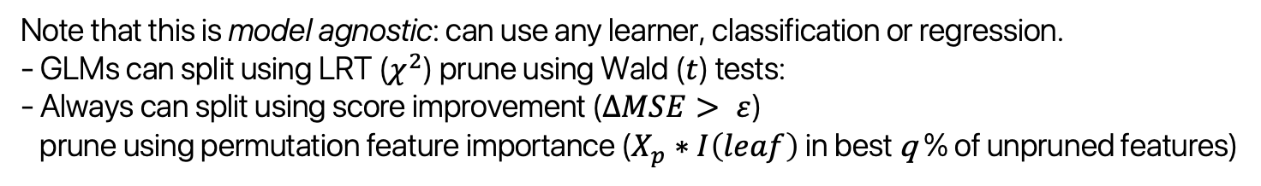
0. INITIALIZE: enqueue a root cell that predicts y ~ X, the “global” model
1. SPLIT: pop the first cell from our queue and split it into four. For each split:
1-1. fit a submodel predicting only outcomes in that cell using data in that cell.
1-2. update predictions for the whole map
1-3. if predictions are significantly better, return the split to the queue & go to 1,
otherwise assign all observations in that split the parent’s label & discard the split.
2. PRUNE: fit a model with all current feature X label interactions (one hot).
2-1. if all terms are significant, go to 3,
otherwise find the deepest non-significant term, d*
2-2. for all non-significant terms at d*
2-2-1. merge the non-significant term into its parent leaf’s term
2-2-2. remove the non-significant term itself and go to 2-1.
3. FINALIZE: Fit a final model on the final design matrix from 2.
Note that this is model agnostic: can use any learner, classification or regression.
- GLMs can split using LRT ($χ^{2}$) prune using Wald ($t$) tests:
- Always can split using score improvement ($∆MSE> ε$)
prune using permutation feature importance ($X_{p}∗I\left(leaf\right)$ in best q % of unpruned features)
THE SUPERVISED QUADTREE

Slide 47
PLACE | METHOD | MSE | R² | TIME
Baltimore | OLS | .16 | .49 | Sub-seconds
n=211 | Skater 15 Regimes | .02 | .93 | Seconds
 | MGWR | .01 | .95 | Seconds
 | SuperQT (no prune) | .04 (.02) | .89 (.94) | Seconds
King’s Co. | OLS | .13 | .53 | Seconds
n=31k | Skater 15 Regimes | .05 | .811 | Hours
 | MGWR | DNF | DNF | DNF
 | SuperQT (no prune) | .06 (.06) | .78 (.78) | Minutes
COMPARISONS

Slide 48
PLACE | METHOD | MSE | R² | TIME
Baltimore | OLS | .16 | .49 | Sub-seconds
n=211 | Skater 15 Regimes | .02 | .93 | Seconds
 | MGWR | .01 | .95 | Seconds
 | SuperQT (no prune) | .04 (.02) | .89 (.94) | Seconds
King’s Co. | OLS | .13 | .53 | Seconds
n=31k | Skater 15 Regimes | .05 | .811 | Hours
 | MGWR | DNF | DNF | DNF
 | SuperQT (no prune) | .06 (.06) | .78 (.78) | Minutes
Small n: usually need eps+perm (lrt+wald dof issues)
Big n: both lrt+wald and eps+perm are useful
COMPARISONS

Slide 49
PLACE | METHOD | MSE | R² | TIME
Baltimore | OLS | .16 | .49 | Sub-seconds
n=211 | Skater 15 Regimes | .02 | .93 | Seconds
 | MGWR | .01 | .95 | Seconds
 | SuperQT (no prune) | .04 (.02) | .89 (.94) | Seconds
King’s Co. | OLS | .13 | .53 | Seconds
n=31k | Skater 15 Regimes | .05 | .811 | Hours
 | MGWR | DNF | DNF | DNF
 | SuperQT (no prune) | .06 (.06) | .78 (.78) | Minutes
Small n: usually need eps+perm (lrt+wald dof issues)
Big n: both lrt+wald and eps+perm are useful
COMPARISONS

Slide 50
PLACE | METHOD | MSE | R² | TIME
Baltimore | OLS | .16 | .49 | Sub-seconds
n=211 | Skater 15 Regimes | .02 | .93 | Seconds
 | MGWR | .01 | .95 | Seconds
 | SuperQT (no prune) | .04 (.02) | .89 (.94) | Seconds
King’s Co. | OLS | .13 | .53 | Seconds
n=31k | Skater 15 Regimes | .05 | .811 | Hours
 | MGWR | DNF | DNF | DNF
 | SuperQT (no prune) | .06 (.06) | .78 (.78) | Minutes
COMPETITIVE EVEN AFTER PRUNING

Slide 51
PLACE | METHOD | MSE | R² | TIME
Baltimore | OLS | .16 | .49 | Seconds
n=211 | Skater 15 Regimes | .02 | .93 | Seconds
 | MGWR | .01 | .95 | Seconds
 | SuperQT (no prune) | .04 (.02) | .89 (.94) | Seconds
King’s Co. | OLS | .13 | .53 | Seconds
n=31k | Skater 15 Regimes | .05 | .811 | Hours
 | MGWR | DNF | DNF | DNF
 | SuperQT (no prune) | .06 (.06) | .78 (.78) | Minute
Pruning is especially powerful in big data:
~90 feature x leaf interactions in Skater & SuperQT
~60 post pruning w/ very small change to fit (for both)
COMPETITIVE EVEN AFTER PRUNING

Slide 52
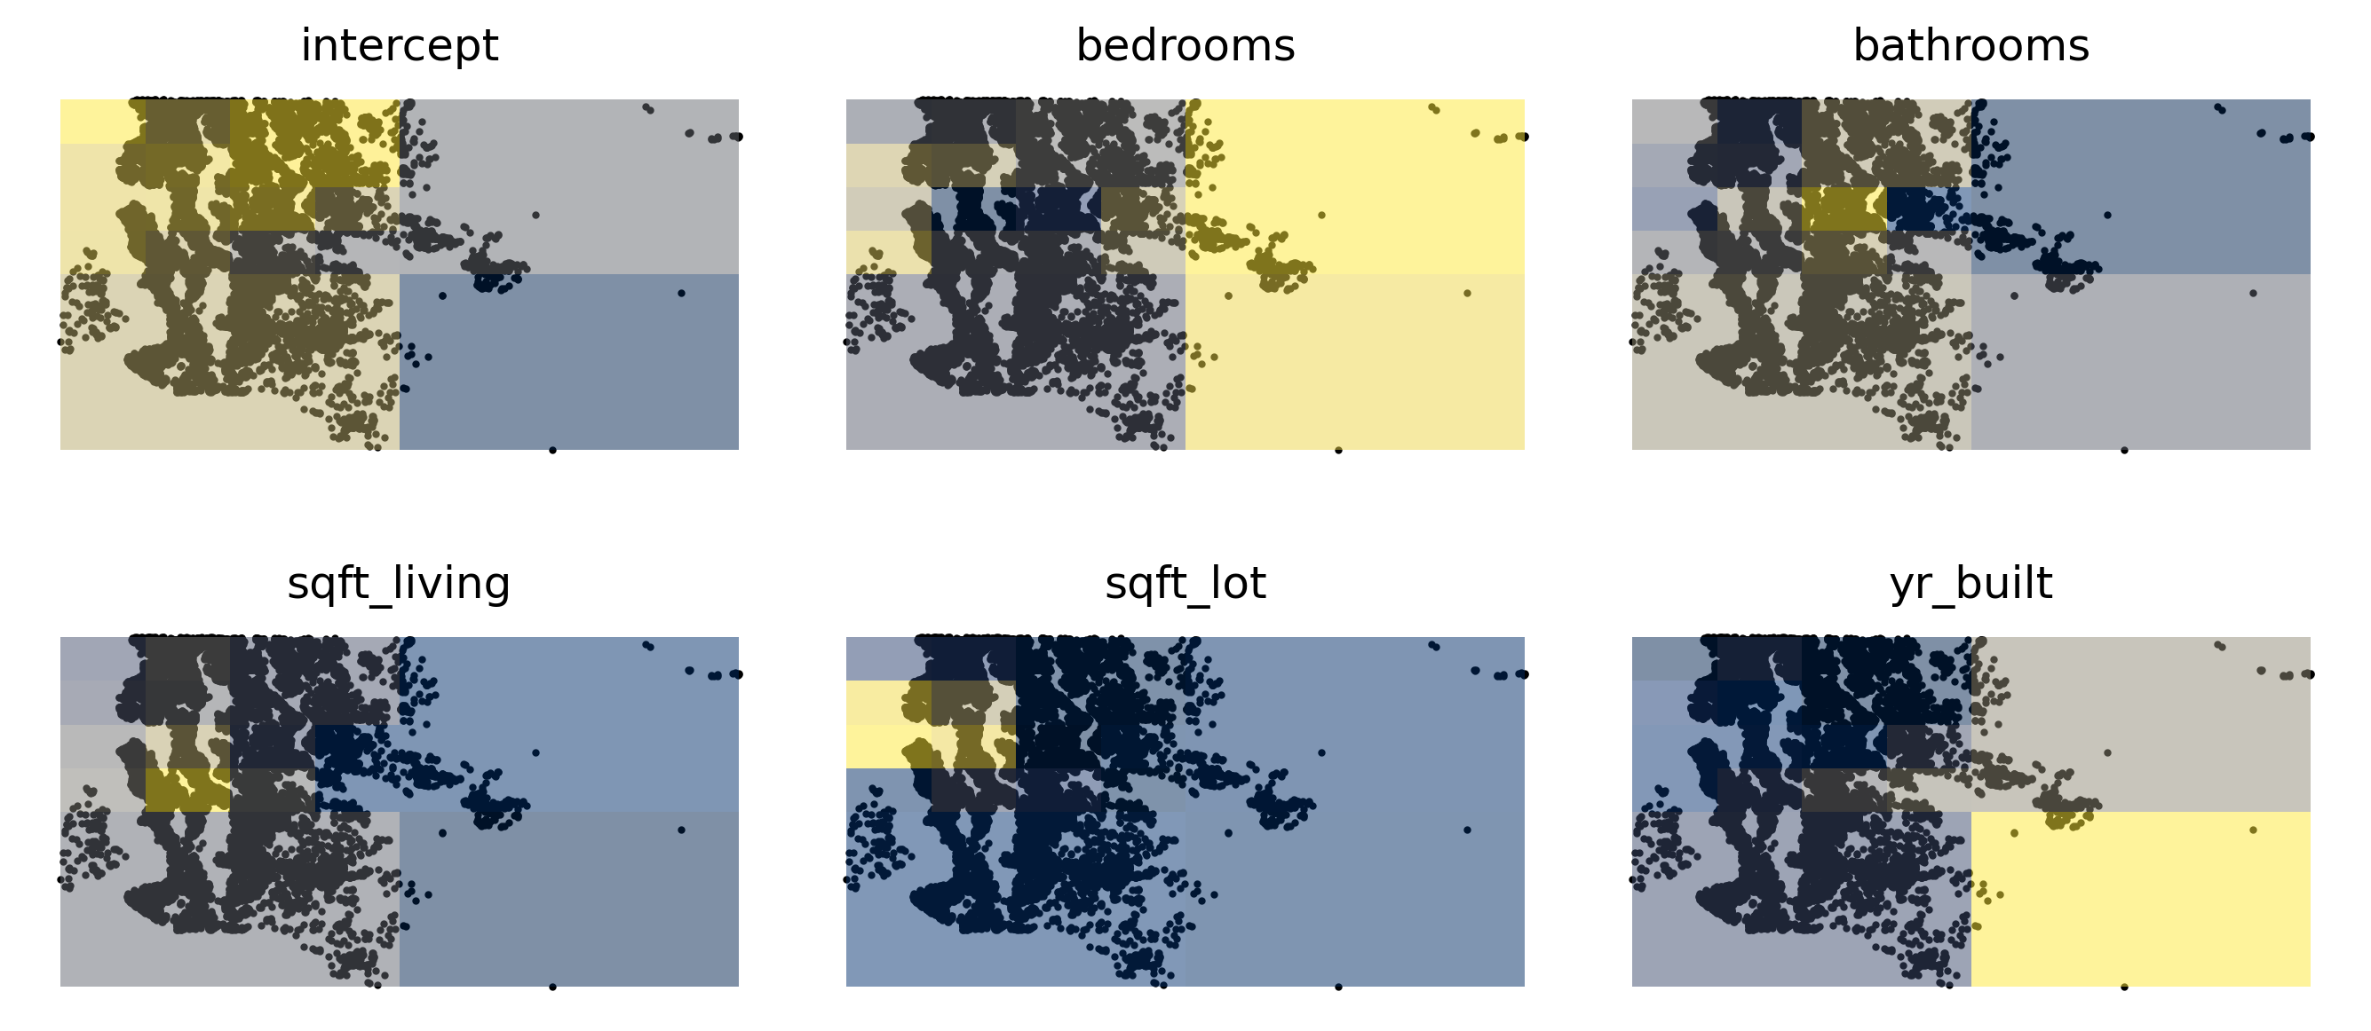
COMPETITIVE EVEN AFTER PRUNING

Slide 53
Prices in general are expensive towards the coast, also in the start-upish areas in the north east.
COMPETITIVE EVEN AFTER PRUNING

Slide 54
Space is at a premium, with living space slightly more expensive south-center.
COMPETITIVE EVEN AFTER PRUNING

Slide 55
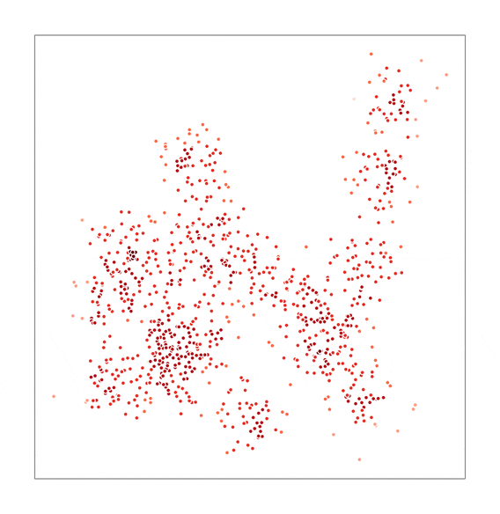
SUPERVISED QUADTREES:
a new algorithm for
local data science
LEVI JOHN WOLF
levi.john.wolf@bristol.ac.uk

